Slide 1
College Technical Math 1
Section 9.4
Writing Equations of a Line

Slide 2
Writing the Equation of a Line
To write the equation of a line you need two criteria:
The slope of the line.
The coordinates of one point on the line.
It is important that you know the different forms of a linear equation.

Slide 3

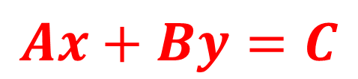
Here are the forms of a linear equation that you will work with in this course.
Standard Form
$$Ax+By=C$$
$$Ex: −3x+2y=12$$
Standard form does not contain any fractions or decimals.

Slide 4
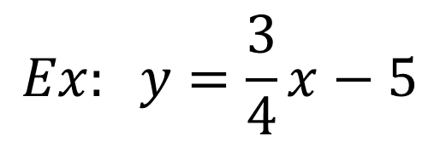
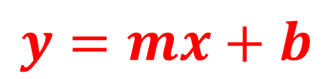
Here are the forms of a linear equation that you will work with in this course.
Slope – Intercept (Function) Form
$$y=mx+b$$
$$Ex: y=\frac{3}{4}x−5$$

Slide 5

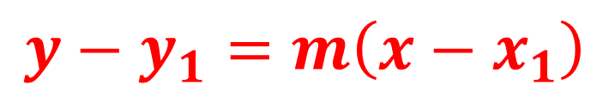
Here are the forms of a linear equation that you will work with in this course.
Point – Slope Form
$$y−y_{1}=m\left(x−x_{1}\right)$$
$$Ex: y−5=4(x−2)$$

Slide 6

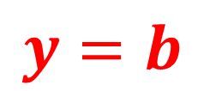
Here are the forms of a linear equation that you will work with in this course.
Horizontal Line Form
$$y=b$$
$$Ex: y=−3$$

Slide 7

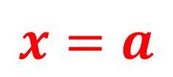
Here are the forms of a linear equation that you will work with in this course.
Vertical Line Form
$$x=a$$
$$Ex: x=9$$

Slide 8
Writing the Equation of a Line
The point-slope form is the easiest form to use when writing the equation of a line.
After writing the equation of the line in point-slope form, you can manipulate the equation into any of the other forms as needed.

Slide 9
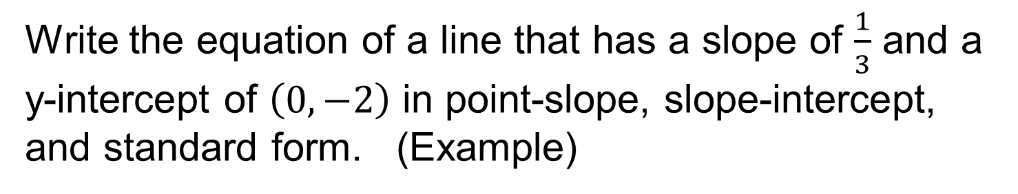
Writing the Equation of a Line
Write the equation of a line that has a slope of $\frac{1}{3}$ and a y-intercept of $\left(0,−2\right)$ in point-slope, slope-intercept, and standard form. (Example)

Slide 10

Writing the Equation of a Line
Write the equation of a line that has a slope of $\frac{1}{3}$ and a y-intercept of $\left(0,−2\right)$ in point-slope, slope-intercept, and standard form. (Example)
$$y−y_{1}=m\left(x−x_{1}\right)$$
Start with the point-slope form of the equation. Substitute the slope and x and y coordinates of the point into this equation.

Slide 11

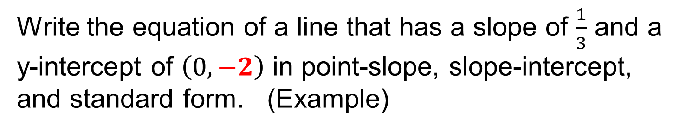

Writing the Equation of a Line
Write the equation of a line that has a slope of $\frac{1}{3}$ and a y-intercept of $\left(0,−2\right)$ in point-slope, slope-intercept, and standard form. (Example)
$$y−y_{1}=m\left(x−x_{1}\right)$$
$$y−(−2)=m\left(x−x_{1}\right)$$

Slide 12
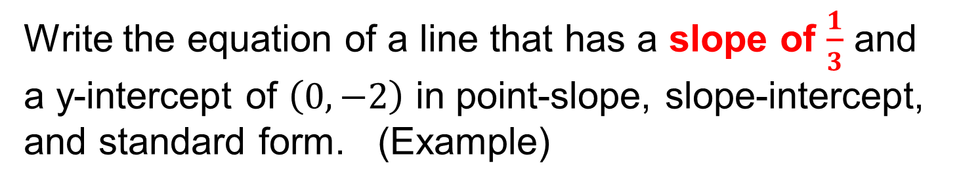
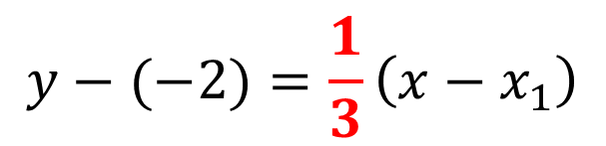
Writing the Equation of a Line
Write the equation of a line that has a slope of $\frac{1}{3}$ and a y-intercept of $\left(0,−2\right)$ in point-slope, slope-intercept, and standard form. (Example)
$$y−y_{1}=m\left(x−x_{1}\right)$$
$$y−(−2)=\frac{1}{3}\left(x−x_{1}\right)$$

Slide 13
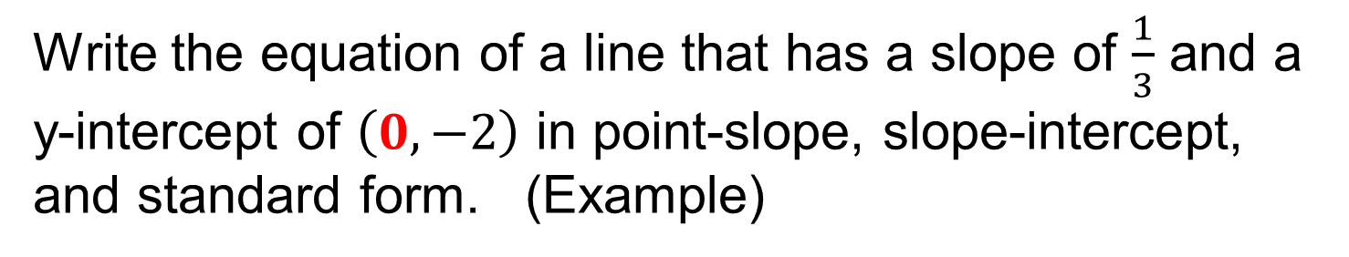
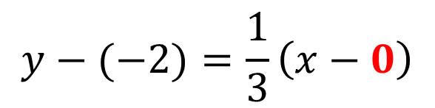
Writing the Equation of a Line
Write the equation of a line that has a slope of $\frac{1}{3}$ and a y-intercept of $\left(0,−2\right)$ in point-slope, slope-intercept, and standard form. (Example)
$$y−y_{1}=m\left(x−x_{1}\right)$$
$$y−(−2)=\frac{1}{3}\left(x−0\right)$$

Slide 14
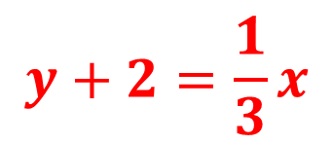
Writing the Equation of a Line
Write the equation of a line that has a slope of $\frac{1}{3}$ and a y-intercept of $\left(0,−2\right)$ in point-slope, slope-intercept, and standard form. (Example)
$$y−y_{1}=m\left(x−x_{1}\right)$$
$$y+2=\frac{1}{3}x$$
This is the point-slope form of the linear equation.

Slide 15
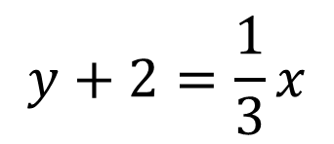
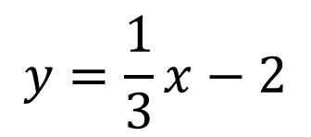
Writing the Equation of a Line
Write the equation of a line that has a slope of $\frac{1}{3}$ and a y-intercept of $\left(0,−2\right)$ in point-slope, slope-intercept, and standard form. (Example)
$$y+2=\frac{1}{3}x$$
Solving for y creates the slope-intercept form of the linear equation.
This is the slope-intercept form of the linear equation.
$$y=\frac{1}{3}x−2$$

Slide 16
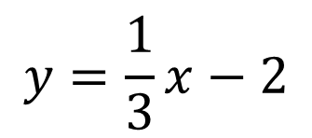


Writing the Equation of a Line
Write the equation of a line that has a slope of $\frac{1}{3}$ and a y-intercept of $\left(0,−2\right)$ in point-slope, slope-intercept, and standard form. (Example)
Standard form has the variable terms on the same side of the equation.
$$y=\frac{1}{3}x−2$$
Standard form does not contain any fractions.
$$3y=x−6$$
$$−x+3y=−6$$

Slide 17
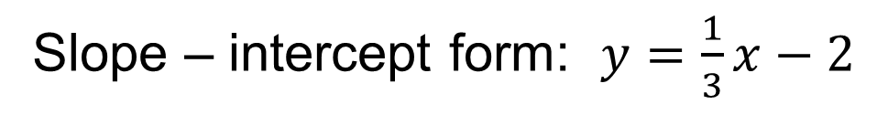
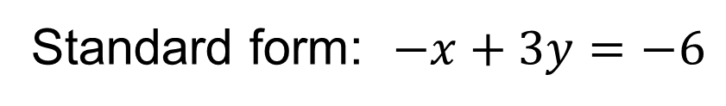
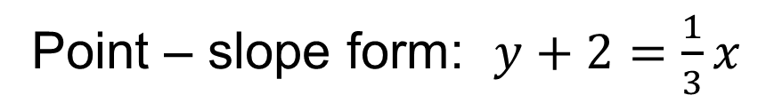
Writing the Equation of a Line
Write the equation of a line that has a slope of $\frac{1}{3}$ and a y-intercept of $\left(0,−2\right)$ in point-slope, slope-intercept, and standard form. (Example)
Point – slope form: $y+2=\frac{1}{3}x$
Slope – intercept form: $y=\frac{1}{3}x−2$
Standard form: $−x+3y=−6$

Slide 18
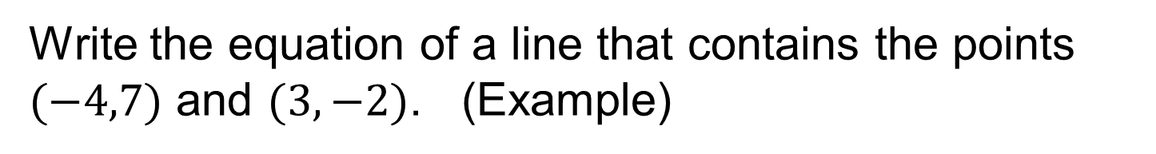
Writing the Equation of a Line
Write the equation of a line that contains the points $(−4,7)$ and $(3,−2)$. (Example)

Slide 19
Writing the Equation of a Line
Write the equation of a line that contains the points $(−4,7)$ and $(3,−2)$. (Example)
We do not know the slope of this line. The first step will be to calculate the slope of the line using the slope formula.

Slide 20
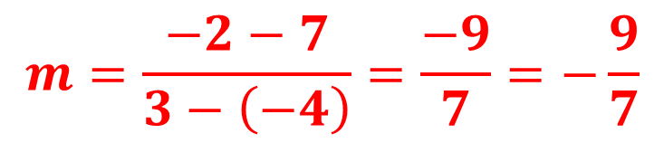
Writing the Equation of a Line
Write the equation of a line that contains the points $(−4,7)$ and $(3,−2)$. (Example)
$$m=\frac{−2−7}{3−\left(−4\right)}=\frac{−9}{7}=−\frac{9}{7}$$

Slide 21
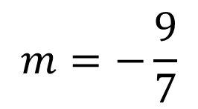
Writing the Equation of a Line
Write the equation of a line that contains the points $(−4,7)$ and $(3,−2)$. (Example)
$$m=−\frac{9}{7}$$
Now that we know the slope of the line, we can use either of the two points with the slope to write the equation of the line.

Slide 22

Writing the Equation of a Line
Write the equation of a line that contains the points $(−4,7)$ and $(3,−2)$. (Example)
$$m=−\frac{9}{7}$$
$$y−y_{1}=m (x−x_{1})$$

Slide 23
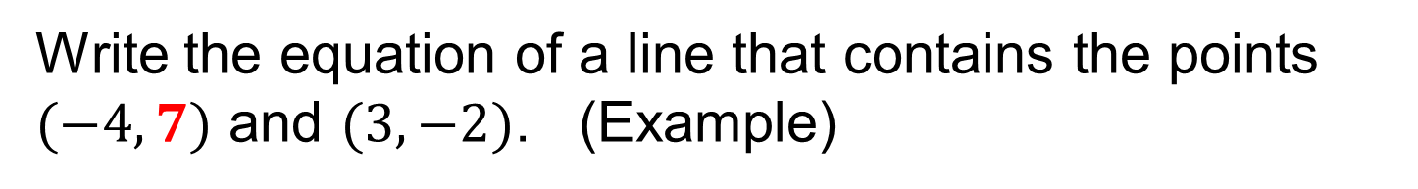

Writing the Equation of a Line
Write the equation of a line that contains the points $(−4,7)$ and $(3,−2)$. (Example)
$$m=−\frac{9}{7}$$
$$y−7=m (x−x_{1})$$

Slide 24
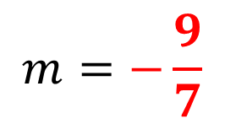
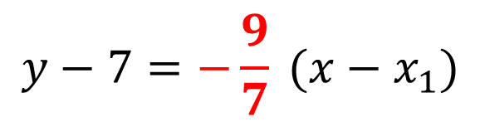
Writing the Equation of a Line
Write the equation of a line that contains the points $(−4,7)$ and $(3,−2)$. (Example)
$$m=−\frac{9}{7}$$
$$y−7=−\frac{9}{7} (x−x_{1})$$

Slide 25
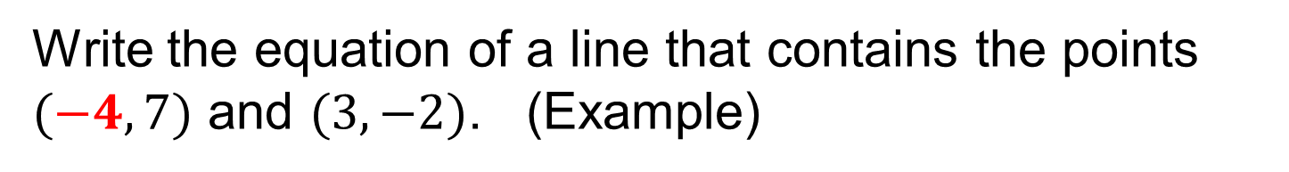
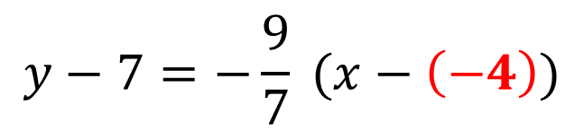
Writing the Equation of a Line
Write the equation of a line that contains the points $(−4,7)$ and $(3,−2)$. (Example)
$$m=−\frac{9}{7}$$
$$y−7=−\frac{9}{7} (x−\left(−4\right))$$

Slide 26
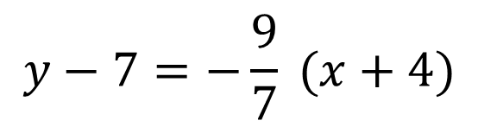
Writing the Equation of a Line
Write the equation of a line that contains the points $(−4,7)$ and $(3,−2)$. (Example)
$$m=−\frac{9}{7}$$
$$y−7=−\frac{9}{7} (x+4)$$

Slide 27
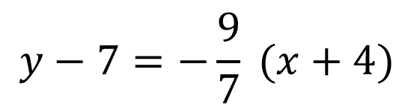
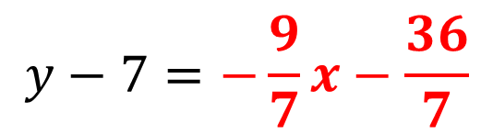
Writing the Equation of a Line
Write the equation of a line that contains the points $(−4,7)$ and $(3,−2)$. (Example)
$$y−7=−\frac{9}{7} (x+4)$$
$$y−7=−\frac{9}{7}x−\frac{36}{7}$$

Slide 28
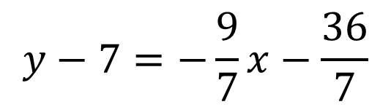
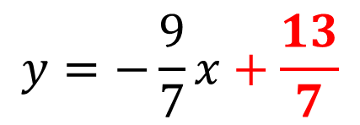
Writing the Equation of a Line
Write the equation of a line that contains the points $(−4,7)$ and $(3,−2)$. (Example)
$$y−7=−\frac{9}{7} (x+4)$$
$$y−7=−\frac{9}{7}x−\frac{36}{7}$$
$$y=−\frac{9}{7}x+\frac{13}{7}$$

Slide 29
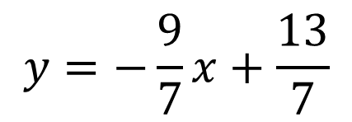
Writing the Equation of a Line
Write the equation of a line that contains the points $(−4,7)$ and $(3,−2)$. (Example)
$$y−7=−\frac{9}{7} (x+4)$$
$$y−7=−\frac{9}{7}x−\frac{36}{7}$$
$$y=−\frac{9}{7}x+\frac{13}{7}$$

Slide 30
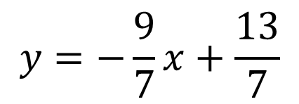

Writing the Equation of a Line
Write the equation of a line that contains the points $(−4,7)$ and $(3,−2)$. (Example)
$$y=−\frac{9}{7}x+\frac{13}{7}$$
$$7y=−9x+13$$

Slide 31


Writing the Equation of a Line
Write the equation of a line that contains the points $(−4,7)$ and $(3,−2)$. (Example)
$$y=−\frac{9}{7}x+\frac{13}{7}$$
$$7y=−9x+13$$
$$9x+7y=13$$

Slide 32

Writing the Equation of a Line
Write the equation of a line that contains the points $(−4,7)$ and $(3,−2)$. (Example)
$$y=−\frac{9}{7}x+\frac{13}{7}$$
$$7y=−9x+13$$
$$9x+7y=13$$

Slide 33
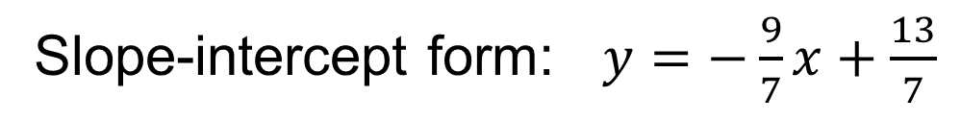
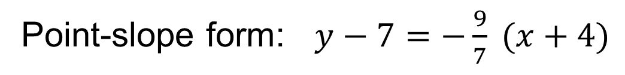
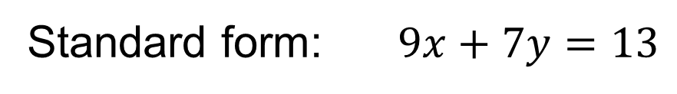
Writing the Equation of a Line
Write the equation of a line that contains the points $(−4,7)$ and $(3,−2)$. (Example)
Point-slope form: $y−7=−\frac{9}{7} (x+4)$
Slope-intercept form: $y=−\frac{9}{7}x+\frac{13}{7}$
Standard form: $9x+7y=13$

Slide 34
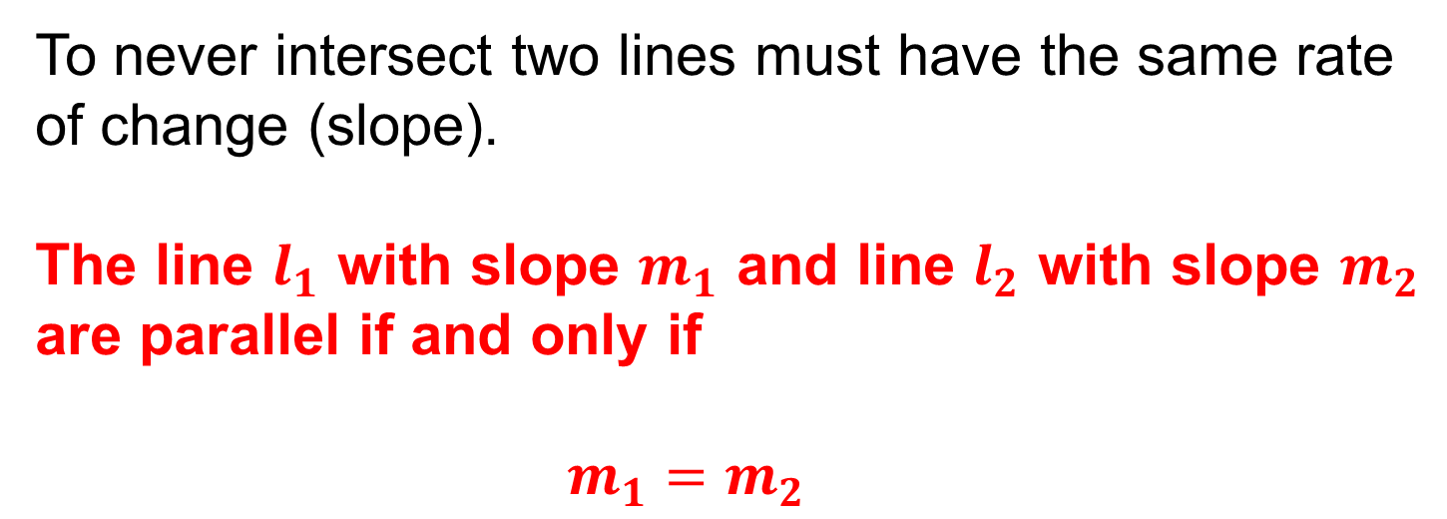
Parallel Lines
Parallel lines are lines in a plane that do not intersect.
To never intersect two lines must have the same rate of change (slope).
The line $l_{1}$ with slope $m_{1}$ and line $l_{2}$ with slope $m_{2}$ are parallel if and only if
$m_{1}=m_{2}$

Slide 35
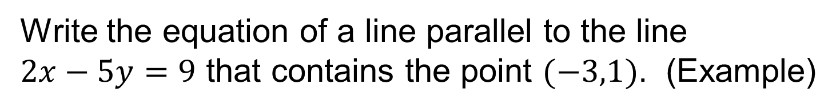
Parallel Lines
Write the equation of a line parallel to the line $2x−5y=9$ that contains the point $(−3,1)$. (Example)

Slide 36
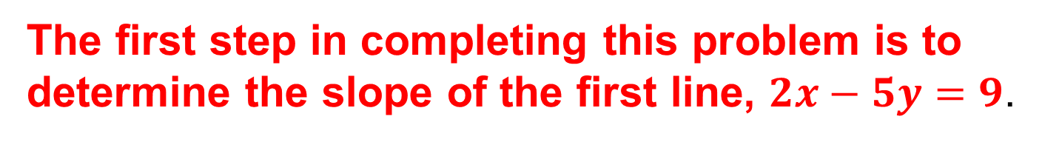
Parallel Lines
Write the equation of a line parallel to the line $2x−5y=9$ that contains the point $(−3,1)$. (Example)
The first step in completing this problem is to determine the slope of the first line, $2x−5y=9$.

Slide 37

Parallel Lines
Write the equation of a line parallel to the line $2x−5y=9$ that contains the point $(−3,1)$. (Example)
$$2x−5y=9$$

Slide 38


Parallel Lines
Write the equation of a line parallel to the line $2x−5y=9$ that contains the point $(−3,1)$. (Example)
$$2x−5y=9$$
$$−5y=9−2x$$

Slide 39

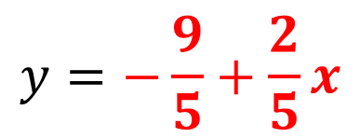
Parallel Lines
Write the equation of a line parallel to the line $2x−5y=9$ that contains the point $(−3,1)$. (Example)
$$2x−5y=9$$
$$−5y=9−2x$$
$$y=−\frac{9}{5}+\frac{2}{5}x$$

Slide 40
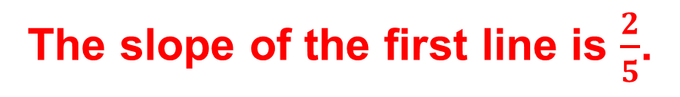
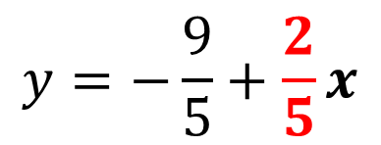
Parallel Lines
Write the equation of a line parallel to the line $2x−5y=9$ that contains the point $(−3,1)$. (Example)
$$2x−5y=9$$
$$−5y=9−2x$$
$$y=−\frac{9}{5}+\frac{2}{5}x$$
The slope of the first line is $\frac{2}{5}$.

Slide 41
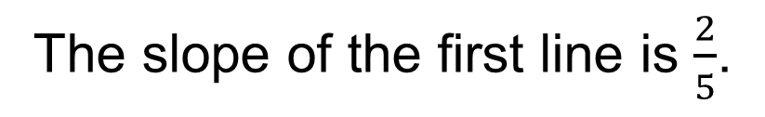
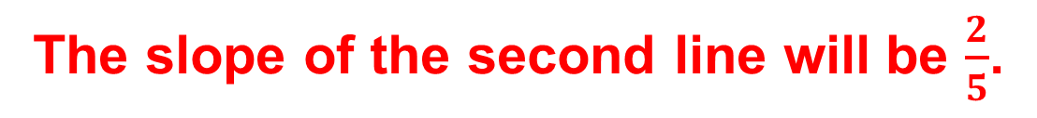
Parallel Lines
Write the equation of a line parallel to the line $2x−5y=9$ that contains the point $(−3,1)$. (Example)
The slope of the first line is $\frac{2}{5}$.
The slope of the second line will be $\frac{2}{5}$.

Slide 42
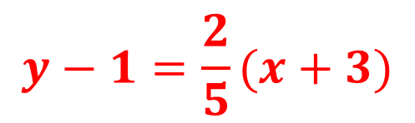
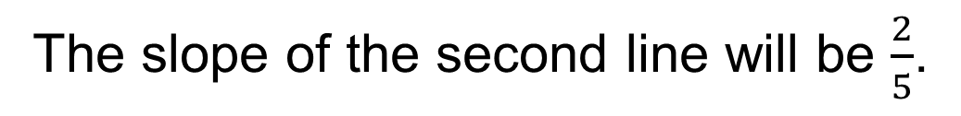
Parallel Lines
Write the equation of a line parallel to the line $2x−5y=9$ that contains the point $(−3,1)$. (Example)
The slope of the first line is $\frac{2}{5}$.
The slope of the second line will be $\frac{2}{5}$.
$$y−1=\frac{2}{5}(x+3)$$

Slide 43
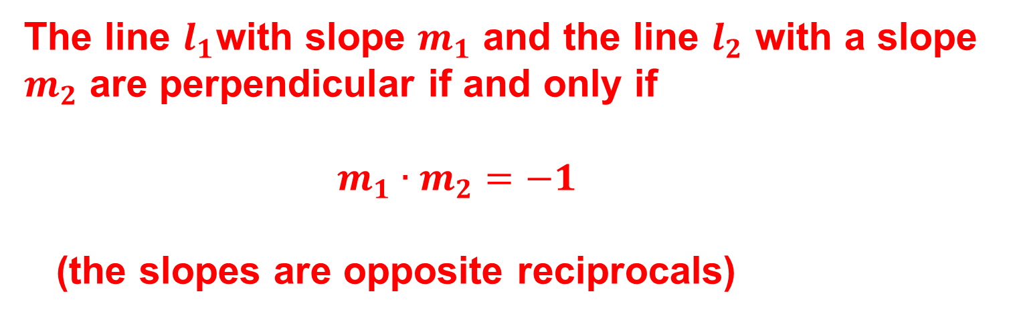
Perpendicular Lines
Lines that are perpendicular intersect to form 4 right angles.
The line $l_{1}$with slope $m_{1}$ and the line $l_{2}$ with a slope $m_{2}$ are perpendicular if and only if
$m_{1}∙m_{2}=−1$
(the slopes are opposite reciprocals)

Slide 44
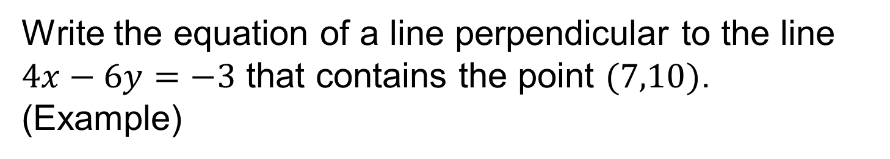
Perpendicular Lines
Write the equation of a line perpendicular to the line $4x−6y=−3$ that contains the point $(7,10)$. (Example)

Slide 45

Perpendicular Lines
Write the equation of a line perpendicular to the line $4x−6y=−3$ that contains the point $(7,10)$. (Example)
$$4x−6y=−3$$

Slide 46

Perpendicular Lines
Write the equation of a line perpendicular to the line $4x−6y=−3$ that contains the point $(7,10)$. (Example)
$$4x−6y=−3$$
$$−6y=−3−4x$$

Slide 47
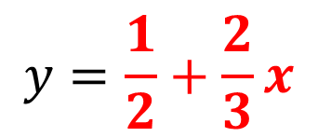

Perpendicular Lines
Write the equation of a line perpendicular to the line $4x−6y=−3$ that contains the point $(7,10)$. (Example)
$$4x−6y=−3$$
$$−6y=−3−4x$$
$$y=\frac{1}{2}+\frac{2}{3}x$$

Slide 48


Perpendicular Lines
Write the equation of a line perpendicular to the line $4x−6y=−3$ that contains the point $(7,10)$. (Example)
$$4x−6y=−3$$
$$−6y=−3−4x$$
$$y=\frac{1}{2}+\frac{2}{3}x$$
The slope of the first line is $\frac{2}{3}.$

Slide 49


Perpendicular Lines
Write the equation of a line perpendicular to the line $4x−6y=−3$ that contains the point $(7,10)$. (Example)
The slope of the first line is $\frac{2}{3}.$
The slope of the second line is $−\frac{3}{2}.$

Slide 50


Perpendicular Lines
Write the equation of a line perpendicular to the line $4x−6y=−3$ that contains the point $(7,10)$. (Example)
The slope of the second line is $−\frac{3}{2}.$
$$y−10=−\frac{3}{2}(x−7)$$

